Slide 1



D A T A A N A L Y S I S I N F U N D . S C I E N C E S
Factors Affecting Student Performance
Yiğit Berk Sarıboğa - 090190354
Erhan Turan - 090200759

Slide 2


Project Introduction
We were interested in examining the variables that may have an impact on the academic performance of high school students.
Variables were examined based on 2 main research questions:
What are the effects of socioeconomic status and family background on the academic performance of high school students?,
Which factors are most crucial for students to be successful in high school?

Slide 3


Data of the Project
About the dataset
The dataset from is a compilation of information about students academic success in mathematics. A wide range of characteristics, including demographic data, study habits, and social factors that could affect student performance, are included in the dataset. The data, which includes student demographic, social, and academic data, was gathered from two secondary schools in Portugal.
Features
The dataset contains 33 variables, mainly including the following:
Gender, age, region of residence, family size, parents' education level, parents' job, student's guardian, home to school travel time, weekly study time, number of past class failures, quality of family relationships, internet access, extra-curricular activities, free time after school, current health status, absences and grades.

Slide 4
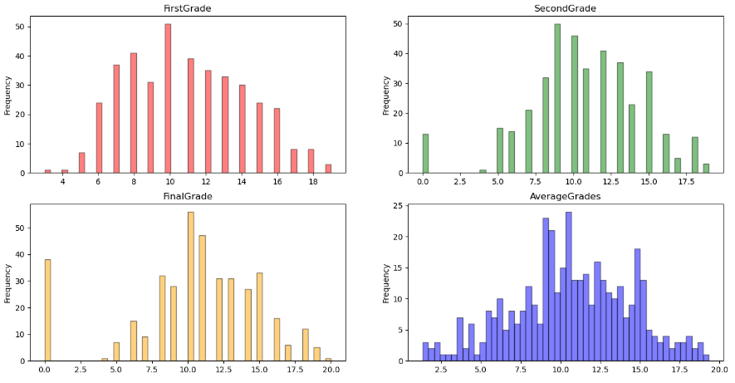
Explatory Data Analysis
Frequency of Grades

Slide 5
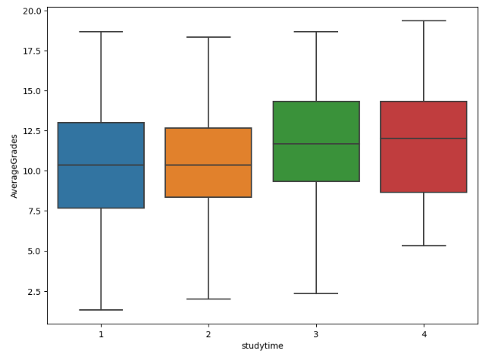
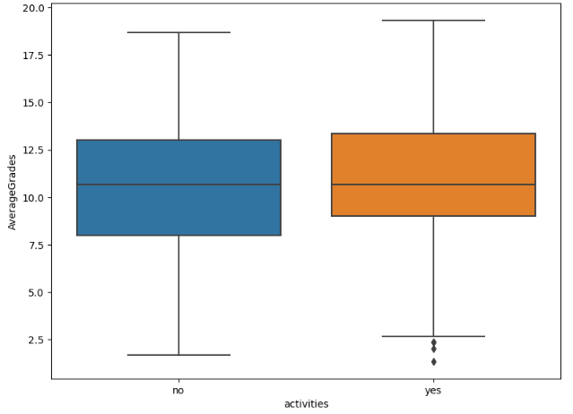
How does a student's academic achievement differ depending on how much time they spend studying?
Do students who participate in extracurricular activities perform better academically than those who do not?

Slide 6
Which factors are most crucial for students to be successful in high school?
The methodologies followed for measuring feature importances were as follows:
Preprocessing:
The training and target data were determined ve splitted.
One-hot encoding used to convert categorical variables into binary vectors.
Feature scaling used to standardize or normalize the range of features in a dataset
Regression Model 1
The best model among the two regression models, DecisionTreeRegressor Model and RandomForestRegressor Model, used to measure feature importances.
Used RandomizedSearchCV to find a better model with help of the tuning hyperparameters.
Regression Model 2
To determine the positive and negative effects of features on grades, Linear Regression and Polynomial Regression models are applied.
After identified the best model, the results are analyzed based on the coefficients to provide insights into the impact of each feature on the grades.
Feature Engineering used to find the optimal subset of features for improving model performance.
Model Selection
The scores of the obtained model were compared by using Mean Squared Error (MSE) and R-squared (R2) metrics to determine the best model.
The models that emerged had good MSE scores, indicating good performance in terms of minimizing the mean squared error. However, they had difficulties in fitting the data accurately.

Slide 7
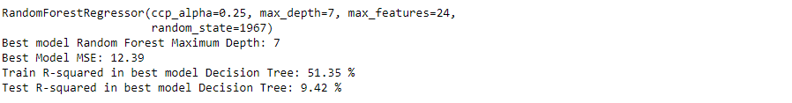
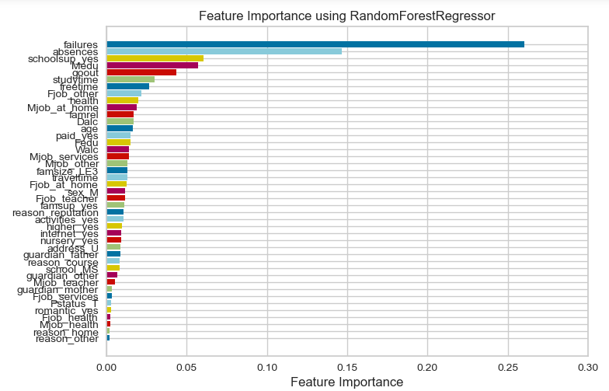
Although a model was obtained with a good MSE score but not fitting well, it was still selected as the best model among the models, and a feature importances graph was shown.

Slide 8
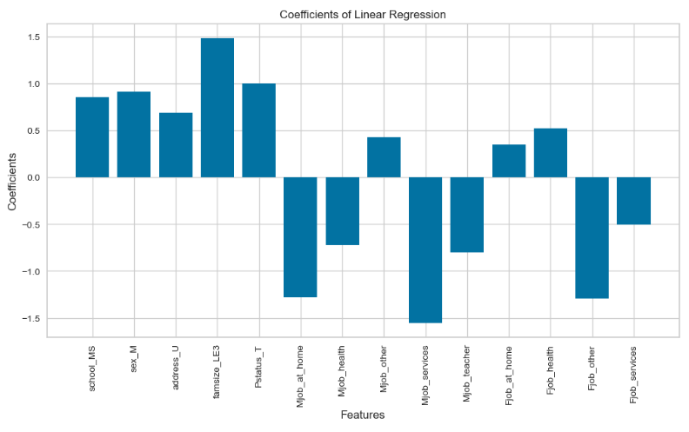

The best model obtained was a linear regression model, despite still having fitting issues, however, this model also achieved a good MSE score, indicating that it performed well in terms of minimizing the mean squared error.
A positive coefficient indicates a positive impact on the target value, while a negative coefficient indicates a negative impact. The magnitude of the coefficients also represents the strength of the effect.
Based on these results, we can conclude that the academic success of students is more dependent on the parental situation and occupations.

Slide 9

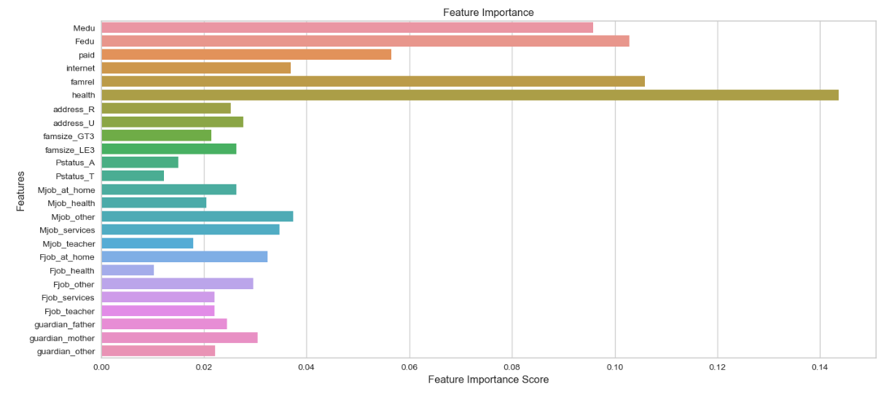
Let's look for answers of "What are the effects of socioeconomic status and family background on the academic performance of high school students?" question.
As we can see from the graph, the most important socioeconomic status and family background features are health, father's education level, mother's education level, quality of family relationships and extra paid classes within the course subject (Math).

Slide 10
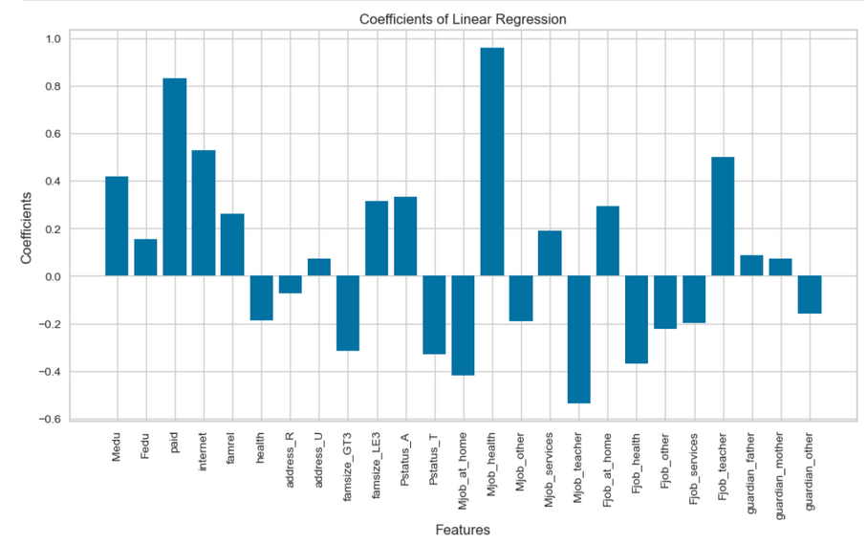
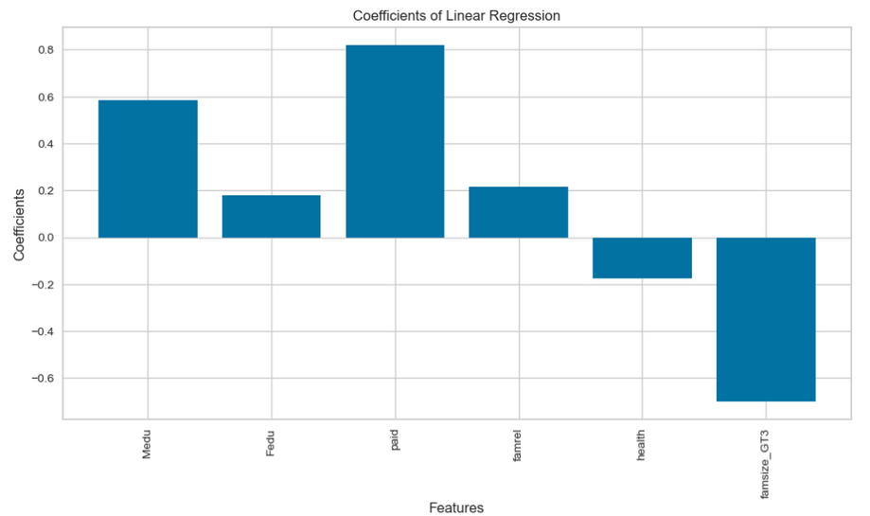
Let's examine the positive or negative effects of features on academic performance using linear regression coefficients.
Without Future Selection
With Future Selection
Positives
paid: Students' access to extra paid courses plays a significant positive role in their academic performance. We can also say that they can be more successful than students who do not have access to these courses.
Medu - Fedu : We can say that there is a positive correlation between parents' high level of education and children's academic performance. In other words, we can claim that as a sociocultural feature, parents' high level of education may be important for children's academic success.
famrel: We can say that the high quality of family relationships is an important positive factor for children's academic success.
Negatives:
famsize: Having more than 3 family members seems to have a negative impact on children's academic performance.
health: As an interesting result, although it has a low reliability, we can see that children with relatively low health can be more successful than healthy children.

Slide 11

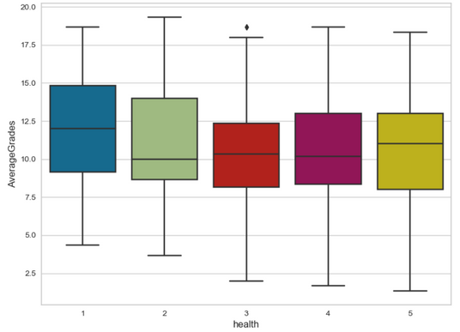
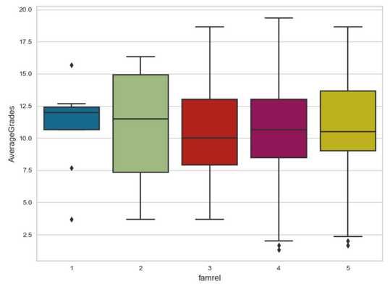
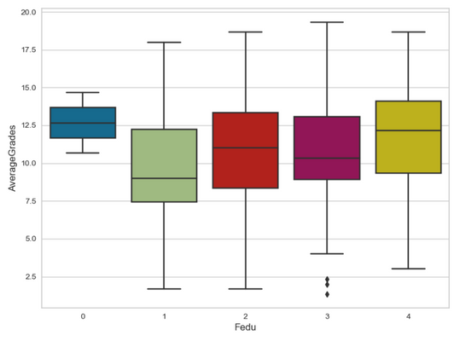
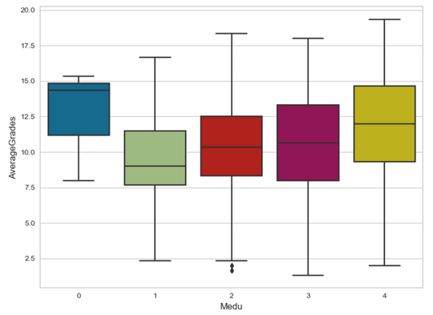
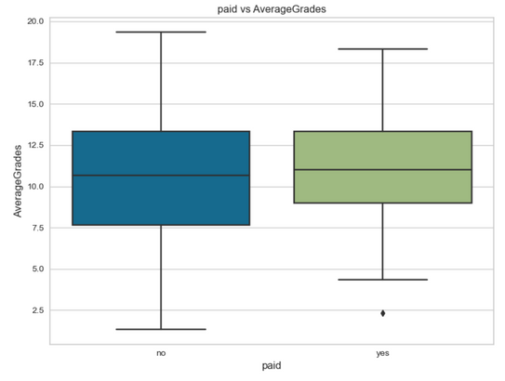
Suggestions: Using this graphs, we can make recommendations for the development of educational policies and practices.
Educational support: Some of the most important features are related to parents' level of education. Therefore, it is important to provide additional educational support for children of parents with low levels of education.
Family relationships: The quality of family relationships also have an impact on academic performance. Schools can work in collaboration with families to organize programs that strengthen family communication and relationships.
Student and family engagement: Schools can reduce the effects of socioeconomic status and family background factors on students' academic performance by organizing activities and programs that encourage student and family involvement.
These recommendations can be considered as steps to reduce the effects of socioeconomic status and family background factors on the academic performance of high school students. Developing educational policies and practices by taking these factors into account may increase students' chances of success.

Slide 12

Results
The Linear Regression model with feature selection outperformed other models in addressing the fitting problem, indicating its effectiveness.
Attributes related to parents, such as family size, parent status, and occupations, had significant positive and negative coefficients, highlighting their impact on student grades.
Family environment and parental involvement were found to play a crucial role in student success, as indicated by the strong effects of parental attributes on academic performance.
The findings emphasize the importance of providing opportunities for extra support, such as access to paid courses, as well as fostering positive family relationships and ensuring a conducive learning environment for students.
Overall, the results suggest that by considering relevant features and using more appropriate models, it is possible to build a more effective model for understanding and predicting factors affecting students' academic success.

Slide 13
Conclusion
This project highlights the significance of various factors in determining students' academic achievements, providing insights for educational institutions and policymakers. Findings emphasize the importance of support opportunities, positive family relationships, and conducive learning environments. Parental involvement and educational attainment play a crucial role. Further research on diverse datasets is recommended for broader generalization. The project serves as a foundation for targeted interventions and strategies to enhance academic outcomes.

Slide 14
Suggestions
Based on the results and conclusion, here are some suggestions to improve students' academic performance and address the identified factors:
Encourage parental involvement: Schools can organize workshops and seminars for parents to emphasize the importance of their role in their children's education.
Provide access to extra courses: Schools and educational institutions can offer additional courses or tutoring programs, either for free or at a reduced cost, to ensure that more students have access to these resources
Strengthen family relationships: Schools can organize family-oriented events and activities that promote positive family interactions and communication.
Address health concerns: Schools can implement health and wellness programs to promote a healthy lifestyle among students.
Offer support for larger families: Schools can provide additional resources and support for students from larger families, such as after-school programs, tutoring, and financial assistance.
Engage with the community: Schools can collaborate with local businesses, organizations, and community members to provide resources, support, and opportunities for students.
By implementing these suggestions, schools and educational institutions can work towards improving students' academic performance and addressing the factors identified in the analysis.

Slide 15

Thanks for Listening to Us

